Slide 1
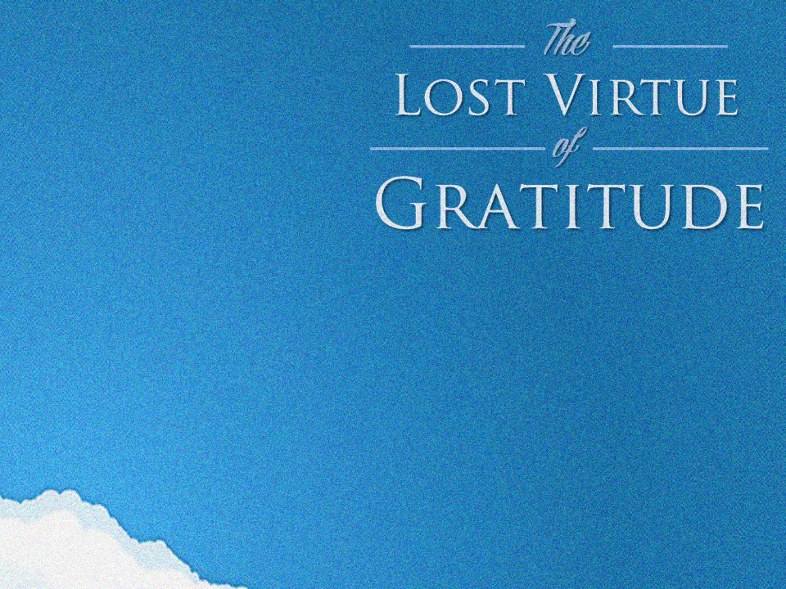

Slide 2
Philosophical Case
Biblical Case
Scientific Case
Cultivating Gratitude

Slide 3
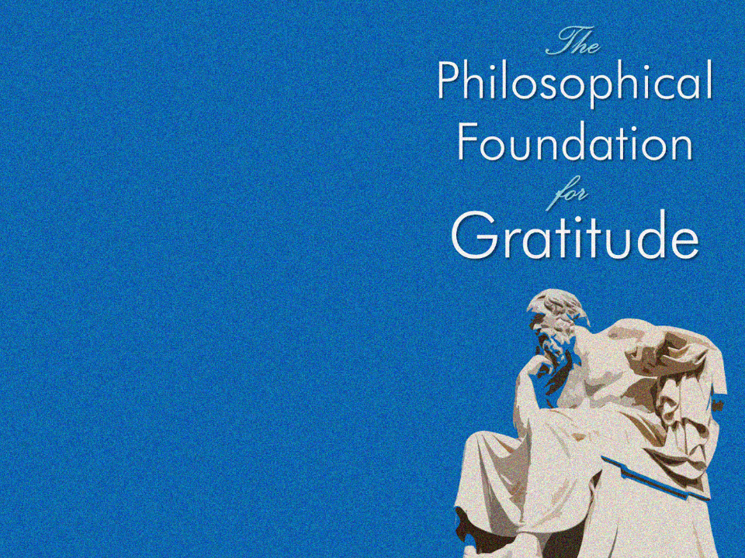
Aristotle
The megalopsycholos (or “great-souled” man) is “the sort of person who does good, but is ashamed when he receives it; for doing good is proper to the superior person, and receiving it to the inferior.”
Aristotle, Nicomachean Ethics (1124b1110–1114).

Slide 4
Aristotle
Joseph Stalin
“[Gratitude] is a sickness suffered by dogs.”
Nikolai Tolstoy, Stalin’s Secret War (1981). Cited in Susan Ratcliffe, Oxford Treasury of Sayings and Quotations (Oxford: Oxford University Press, 2011), 196.

Slide 5
Aristotle
Joseph Stalin
G.K. Chesterton
“The worst moment for an atheist is when he is really thankful and has no one to thank.”
G.K. Chesterton, St. Francis of Assisi, 74-77.

Slide 6
Biblical gratitude is not equivalent to “New Age mind power.”
Our beliefs have a massive effect in us…
But they do not affect the external world around us!
Aristotle
Joseph Stalin
G.K. Chesterton
New Age thought

Slide 7
“The Pharisee [said], ‘God, I thank You
Aristotle
Joseph Stalin
G.K. Chesterton
New Age thought
Legalistic religious systems

Slide 8
“The Pharisee [said], ‘God, I thank You that I am not like other people:
swindlers, unjust, adulterers, or even like this tax collector. I fast twice a week; I pay tithes of all that I get’” (Lk. 18:11-12).
Aristotle
Joseph Stalin
G.K. Chesterton
New Age thought
Legalistic religious systems

Slide 9
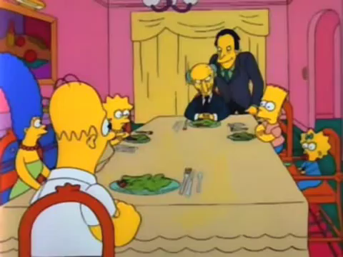
“The Pharisee [said], ‘God, I thank You that I am not like other people: swindlers, unjust, adulterers, or even like this tax collector. I fast twice a week; I pay tithes of all that I get’” (Lk. 18:11-12).
Aristotle
Joseph Stalin
G.K. Chesterton
New Age thought
Legalistic religious systems

Slide 10
Grounded in God’s love for us who are unrighteous, rather than in self-righteousness.
“Gratitude” (Latin gratia) which means “grace, graciousness, or gratefulness.”
“Thanksgiving” (Greek eucharistos).
Why does God command us to give thanks?
Not for His benefit.
But for ours!
Aristotle
Joseph Stalin
G.K. Chesterton
New Age thought
Legalistic religious systems
Biblical gratitude
Notes:
Regarding psalm 50, C.S. Lewis writes, “Even if such an absurd Deity could be conceived, He would hardly come to us, the lowest of rational creatures, to gratify His appetite. I don’t want my dog to bark approval of my books. Now that I come to think of it, there are some humans whose enthusiastically favourable criticism would not much gratify me.”
C.S. Lewis, Reflections on the Psalms (New York: Harvest Book; Houghton Mifflin, 1958), 93.

Slide 11
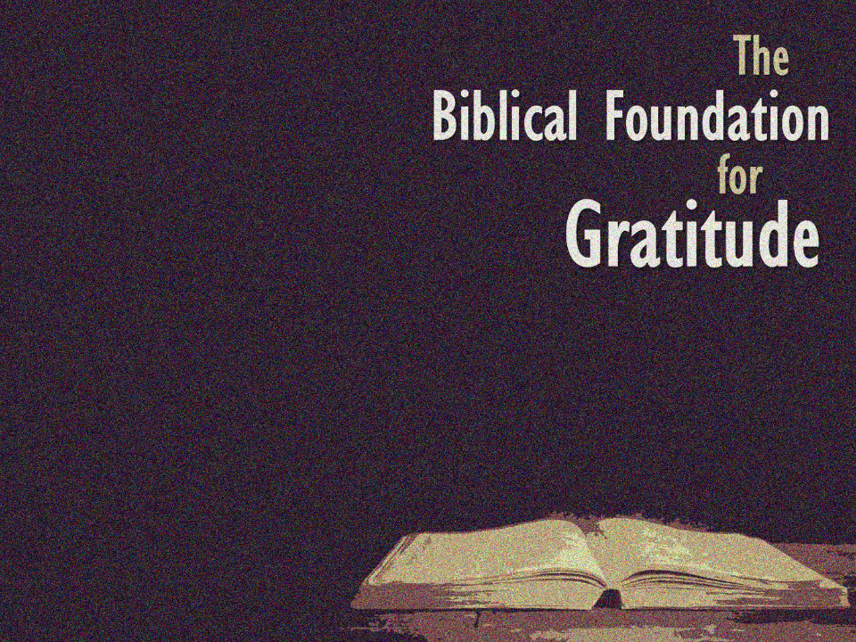
“Even though they knew God, they did not honor Him as God or give thanks, but they became futile in their speculations, and their foolish heart was darkened” (Rom. 1:21).
Why do I feel dull and lifeless when it comes to spiritual things?

Slide 12
(Lk. 17:12) As [Jesus] entered a village, ten leprous men who stood at a distance met Him;
¹³ and they raised their voices, saying, “Jesus, Master, have mercy on us!”
Why do I always feel like God is holding back on me?

Slide 13
(Lk. 17:14) When He saw them, He said to them,
“Go and show yourselves to the priests.”
And as they were going, they were cleansed.
Why do I always feel like God is holding back on me?
Notes:
Leprosy (i.e. Hansen’s disease) invades the nervous system through a microbacterium that causes numbness, leaving the person prone to injury, sores, and blisters.

Slide 14
(Lk. 17:15) Now one of them, when he saw that he had been healed, turned back, glorifying God with a loud voice,
¹⁶ and he fell on his face at His feet, giving thanks to Him. And he was a Samaritan.
Why do I always feel like God is holding back on me?

Slide 15
(Lk. 17:17) Then Jesus answered and said,
“Were there not ten cleansed?
But the nine—where are they?”
What an honest picture of human nature!
Why do I always feel like God is holding back on me?

Slide 16
“Be filled with the Spirit…
always giving thanks for all things in the name of our Lord Jesus Christ to God” (Eph. 5:18-20).
Why do I feel like my efforts to serve God lack His power?

Slide 17
“Devote yourselves to prayer, keeping alert in it with an attitude of thanksgiving” (Col. 4:2).
“First of all, then, I urge that entreaties and prayers, petitions and thanksgivings, be made on behalf of all men” (1 Tim. 2:1).
“Rejoice always; pray without ceasing; in everything give thanks; for this is God’s will for you in Christ Jesus” (1 Thess. 5:16-18).
Why have I never really been able to develop a healthy prayer life?

Slide 18
(Phil. 4:6-7) “Be anxious for nothing,
but in everything by prayer and supplication
with thanksgiving
let your requests be made known to God.
And the peace of God, which surpasses all comprehension, will guard your hearts and your minds in Christ Jesus.”
Why am I gripped with anxiety when I’m not in any real danger?

Slide 19
“As you have received Christ Jesus the Lord, so walk in Him, having been firmly rooted and now being built up in Him and established in your faith… and overflowing with gratitude” (Col. 2:6-7).
Why have I become less passionate for Christ over time?

Slide 20
“Let the peace of Christ rule in your hearts, to which indeed you were called in one body;
and be thankful” (Col. 3:15).
Why am I habitually in conflict with other believers around me?

Slide 21
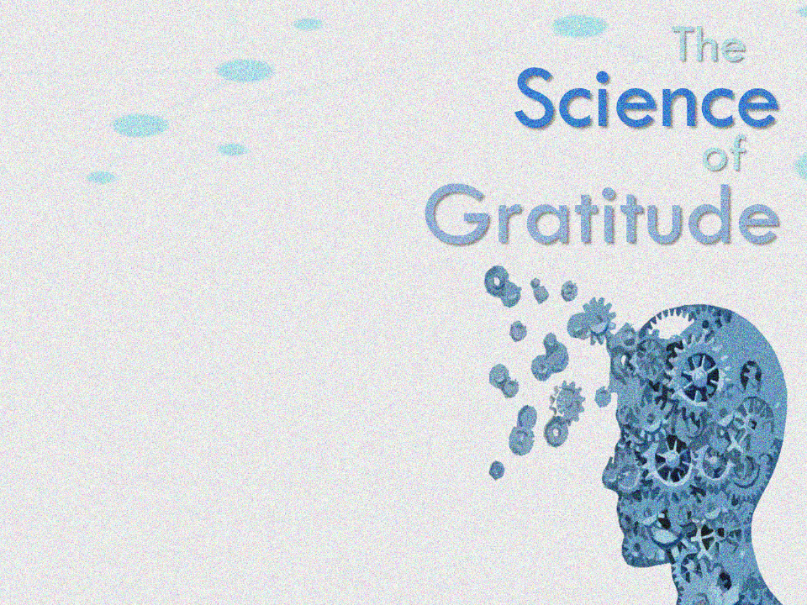
Effects on:
1. Emotional health

Slide 22
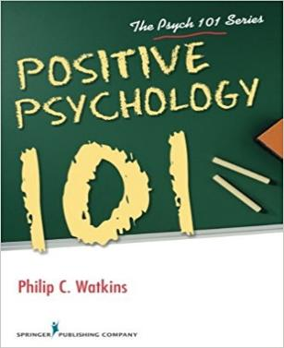
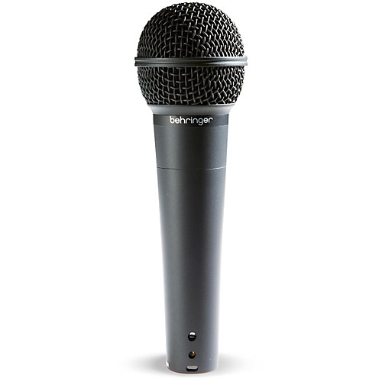
Gratitude encourages happiness by amplifying the good in one’s life.
Philip Watkins
(Professor of psychology at Eastern Washington University)
Philip Watkins, Positive Psychology 101 (New York: Springer Publishing Co., 2016), 74.

Slide 23
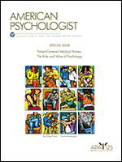
[The “gratitude visit” immediately increased happiness by 10%.
But these results cut in half in a week, and were totally gone in six months.]
Martin Seligman
(University of Pennsylvania Psychologist and President of the APA in 1998)
Martin Seligman, “Positive Psychology Progress.” American Psychologist, 60 (5), 2005, 410-421.

Slide 24
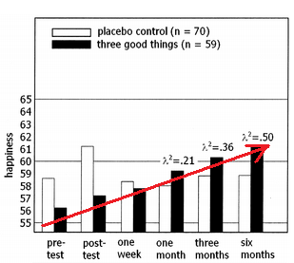
[The “three good things” exercise produced only a 2% increase in happiness in a week, a 5% increase after a month, but 9% at six months.]
Martin Seligman
(University of Pennsylvania Psychologist and President of the APA in 1998)
Martin Seligman, “Positive Psychology Progress.” American Psychologist, 60 (5), 2005, 410-421.

Slide 25
[Depressive symptoms declined by 28% after one week, and continued to lower as it continued.]
Martin Seligman
(University of Pennsylvania Psychologist and President of the APA in 1998)
Martin Seligman, “Positive Psychology Progress.” American Psychologist, 60 (5), 2005, 410-421.

Slide 26
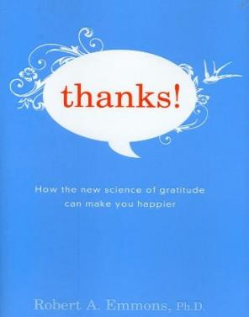
[Study #1: On a weekly regimen, three different groups recorded either (1) “blessings,” (2) “hassles,” or (3) “events.”]
Robert Emmons
(Psychologist at University of California)
Robert Emmons, Thanks! How the New Science of Gratitude Can Make You Happier (New York: Houghton Mifflin Co., 2007).

Slide 27
[The blessings group] were a full 25 percent happier than the other participants.
Robert Emmons
(Psychologist at University of California)
Robert Emmons, Thanks! How the New Science of Gratitude Can Make You Happier (New York: Houghton Mifflin Co., 2007), 30.

Slide 28
[In another study] “Significant others rated participants in the gratitude group as actually more helpful compared to those in the other groups.”
Robert Emmons
(Psychologist at University of California)
Robert Emmons, Thanks! How the New Science of Gratitude Can Make You Happier (New York: Houghton Mifflin Co., 2007), 31-32.

Slide 29
(These friends were not aware of which experimental condition the participants were in).
Robert Emmons
(Psychologist at University of California)
Robert Emmons, Thanks! How the New Science of Gratitude Can Make You Happier (New York: Houghton Mifflin Co., 2007), 31-32.

Slide 30
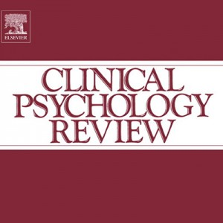
[Dr. Alex Wood was originally a skeptic of gratitude research, thinking it was simply New Age pseudoscience.]
Alex Wood
(Professor of Behavioral Science at the University of Stirling)
Alex M. Wood (et al.), “Gratitude and well-being: A review and theoretical integration” Clinical Psychology Review (2010).

Slide 31
12 studies have supported the link between gratitude and subjective well-being.
Alex Wood
(Professor of Behavioral Science at the University of Stirling)
Alex M. Wood (et al.), “Gratitude and well-being: A review and theoretical integration” Clinical Psychology Review (2010), 6.

Slide 32
Thankfulness predicted signiﬁcantly lower risk of major depression, generalized anxiety disorder, phobia, nicotine dependence, alcohol dependence, and drug ‘abuse’ or dependence.
Alex Wood
(Professor of Behavioral Science at the University of Stirling)
Alex M. Wood (et al.), “Gratitude and well-being: A review and theoretical integration” Clinical Psychology Review (2010), 4-5.

Slide 33
Additionally, thankfulness was related to a much lower risk of bulimia nervosa…
Increase[d] gratitude may have beneﬁts for people with PTSD.
Alex Wood
(Professor of Behavioral Science at the University of Stirling)
Alex M. Wood (et al.), “Gratitude and well-being: A review and theoretical integration” Clinical Psychology Review (2010), 4-5.

Slide 34
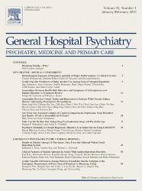
[He gave the patients nine different positive psychological exercises.
The two best exercises were writing a “gratitude letter” and “counting [their] blessings.”
Jeff Huffman
(Associate Professor of Psychiatry at Harvard Medical School)
Jeff C. Huffman (et al.), “Feasibility and utility of positive psychology exercises for suicidal inpatients,” General Hospital Psychiatry, 36 (2014) 88–94.

Slide 35
Effects on:
1. Emotional health
2. Physical health

Slide 36
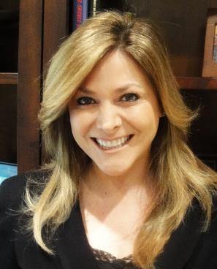
At a biological level, we find that people who are higher in gratitude have lower resting blood pressure.
Wendy Mendes
(University of California, social and biological psychologist)
Lecture given for the John Templeton Foundation’s “Greater Good Science Center” (2014), Wendy Mendes, “Effects of Measured and Manipulated Gratitude on Biomarkers of Health and Aging.”

Slide 37
When we expose them to a stressor, they also respond with lower blood pressure responses…
Wendy Mendes
(University of California, social and biological psychologist)
Lecture given for the John Templeton Foundation’s “Greater Good Science Center” (2014), Wendy Mendes, “Effects of Measured and Manipulated Gratitude on Biomarkers of Health and Aging.”

Slide 38
Higher levels of gratitude are related to higher good cholesterol and lower bad cholesterol.
Wendy Mendes
(University of California, social and biological psychologist)
Lecture given for the John Templeton Foundation’s “Greater Good Science Center” (2014), Wendy Mendes, “Effects of Measured and Manipulated Gratitude on Biomarkers of Health and Aging.”
Again, NOT New Age mind power, but likely related to the physiological effects of stress.
Alex M. Wood (et al.), “Gratitude and well-being: A review and theoretical integration” Clinical Psychology Review (2010), 7.

Slide 39
People who scored high on optimism had a 50 percent lower risk of premature death than those who scored as being more pessimistic.
Robert Emmons
(Psychologist at University of California)
Robert Emmons, Thanks! How the New Science of Gratitude Can Make You Happier (New York: Houghton Mifflin Co., 2007), 67.

Slide 40
Effects on:
1. Emotional health
2. Physical health
3. Relational health

Slide 41
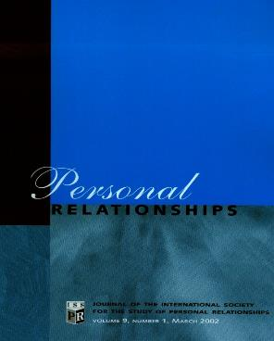
[Both partners answered yes or no to these two statements: (1) “I did something thoughtful for my partner” and (2) “My partner did something thoughtful for me.”]
Sara Algoe
(Professor of Psychology at the University of North Carolina, Chapel Hill)
Sara B. Algoe (et al.), “It’s the little things: Everyday gratitude as a booster shot for romantic relationships,” Personal Relationships, 17 (2010), 228.

Slide 42
[Then they rated their emotions on a scale of 0-6. Then finally, participants answered the question: “Today our relationship was _______.” (1-9 scale).]
Sara Algoe
(Professor of Psychology at the University of North Carolina, Chapel Hill)
Sara B. Algoe (et al.), “It’s the little things: Everyday gratitude as a booster shot for romantic relationships,” Personal Relationships, 17 (2010), 228.

Slide 43
[When one person reported feeling more gratitude from their partner,
their partner independently felt better about the relationship than they did the day before.]
Sara Algoe
(Professor of Psychology at the University of North Carolina, Chapel Hill)
Sara B. Algoe (et al.), “It’s the little things: Everyday gratitude as a booster shot for romantic relationships,” Personal Relationships, 17 (2010), 228.

Slide 44
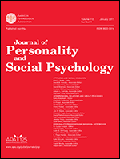
[Gottman performed a study of 73 married couples where he quantified positive versus negative interactions between couples.]
John Gottman
(Professor Emeritus of Psychology at the University of Washington)
John Gottman, “Marital processes predictive of later dissolution: Behavior, physiology, and health,” Journal of Personality and Social Psychology, Vol 63 (2), Aug 1992, 221-233.

Slide 45
[For instance, a contemptuous facial expression (-0.4) measured differently than an expression of disgust (-3.0) or whining (-1.0).]
John Gottman
(Professor Emeritus of Psychology at the University of Washington)
John Gottman, “Marital processes predictive of later dissolution: Behavior, physiology, and health,” Journal of Personality and Social Psychology, Vol 63 (2), Aug 1992, 221-233.

Slide 46
[After filming the couples having conflict, he was able to predict with 94% accuracy whether they would stay married or get divorced.]
John Gottman
(Professor Emeritus of Psychology at the University of Washington)
John Gottman, “Marital processes predictive of later dissolution: Behavior, physiology, and health,” Journal of Personality and Social Psychology, Vol 63 (2), Aug 1992, 221-233.

Slide 47
[His famous ratio is that couples need five positive interactions for
every one negative interaction (5:1).]
John Gottman
(Professor Emeritus of Psychology at the University of Washington)
John Gottman, “Marital processes predictive of later dissolution: Behavior, physiology, and health,” Journal of Personality and Social Psychology, Vol 63 (2), Aug 1992, 221-233.

Slide 48
Our role—not God’s role.
Notes:
Gratitude is our role—not God’s. God has an enormous role in our spiritual growth and maturity: He died on the Cross to purchase our forgiveness, he gave us the Holy Spirit, he made us his sons and daughters, he guaranteed us an inheritance in heaven for all eternity, he committed to meeting our needs, he promised to give us wisdom when we ask, he placed us in Christian community, and he gave us gifts to serve him and others…
But what is our role in spiritual growth? Our responsibility, which God will not violate, is for us to learn to regularly say, “Thank you.” If you are waiting around for God to make you a more grateful person, don’t hold your breath… You will be waiting a very long time! God will not make us grateful people. Gratitude comes to those who choose it.

Slide 49
To “recognize” is to re-cognize.
Our role—not God’s role.
Requires thoughtful reflection.
“Let all that I am praise the Lord; may I never forget the good things he does for me” (Ps. 103:2).

Slide 50
Our role—not God’s role.
Requires thoughtful reflection.
Avoid platitudes and clichés.
Ask the question, “Why am I thankful for that?”

Slide 51
Imagine if…
You thought you might go to hell if you died tomorrow.
You could never read the Bible for the rest of your life.
You had never met any of your close Christian friends.
You (or your loved ones) weren’t going to live to see the end of the month.
Our role—not God’s role.
Requires thoughtful reflection.
Avoid platitudes and clichés.
Imagine if various gifts were taken away.

Slide 52
Our role—not God’s role.
Requires thoughtful reflection.
Avoid platitudes and clichés.
Imagine if various gifts were taken away.
Focus on expressing gratitude, rather than just feeling it.

Slide 53
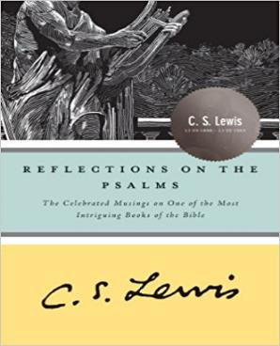
I think we delight to praise what we enjoy because the praise not merely expresses but completes the enjoyment…
C.S. Lewis
(Christian academic, author, apologist)
C.S. Lewis, Reflections on the Psalms (New York: Harvest Book; Houghton Mifflin, 1958), 95.

Slide 54
It is not out of compliment that lovers keep on telling one another how beautiful they are; the delight is incomplete till it is expressed.
C.S. Lewis
(Christian academic, author, apologist)
C.S. Lewis, Reflections on the Psalms (New York: Harvest Book; Houghton Mifflin, 1958), 95.

Slide 55
Potential areas to explore:
For how God made me.
Psalms 139:14
2 Corinthians 12:9-10

Slide 56
1 Thessalonians 4:3
Philippians 1:6
Romans 7:24-25
Potential areas to explore:
For how God made me.
For God’s power in spiritual growth.

Slide 57
2 Corinthians 2:14
Hebrews 12:28
Galatians 6:9
Matthew 16:18
Potential areas to explore:
For how God made me.
For God’s power in spiritual growth.
For God’s power in spiritual service.

Slide 58
Paul gave thanks for the churches in:
Rome (Rom. 1:8).
Asia Minor (Eph. 1:16).
Philippi (Phil. 1:3).
Colossae (Col. 1:3).
Corinth (1 Cor. 1:4).
Thessalonica (1 Thess. 1:2).
All the Gentile churches (Rom. 16:4).
Potential areas to explore:
For how God made me.
For God’s power in spiritual growth.
For God’s power in spiritual service.
For those under our spiritual care.

Slide 59
Potential areas to explore:
For how God made me.
For God’s power in spiritual growth.
For God’s power in spiritual service.
For those under our spiritual care.
For the privilege of serving God.
1 Timothy 1:12-13
2 Corinthians 4:1

Slide 60
“[God] Himself is kind to ungrateful and evil men” (Lk. 6:35).
“She knows how I feel.”
“When is the last time I told her how much I appreciate her love, sacrifice, and hard work?”
Potential areas to explore:
For how God made me.
For God’s power in spiritual growth.
For God’s power in spiritual service.
For those under our spiritual care.
For the privilege of serving God.
Marriage, kids, work.

Slide 61
More than mere etiquette.
“Three things” every night.
When we sit around the dinner table, do we spend most of our time complaining about serving God?
What might this communicate?
Potential areas to explore:
For how God made me.
For God’s power in spiritual growth.
For God’s power in spiritual service.
For those under our spiritual care.
For the privilege of serving God.
Marriage, kids, work.

Slide 62
Current job was the lowest on the list.
Work was the least likely place for people to express gratitude.
However, people desired to be thanked more often at work!
Gratitude Study for the John Templeton Foundation: Emiliana R. Simon-Thomas & Jeremy Adam Smith, “How Grateful are Americans?” Greater Good Magazine (January 10, 2013),
(Phil. 2:14-16) Do all things without grumbling or disputing; so that you will prove yourselves to be blameless and innocent, children of God above reproach in the midst of a crooked and perverse generation, among whom you appear as lights in the world, holding fast the word of life.
Potential areas to explore:
For how God made me.
For God’s power in spiritual growth.
For God’s power in spiritual service.
For those under our spiritual care.
For the privilege of serving God.
Marriage, kids, work.
Notes:
Bullet points taken from Emiliana R. Simon-Thomas & Jeremy Adam Smith, “How Grateful are Americans?” Greater Good Magazine (January 10, 2013), found here.

Slide 63
Current job was the lowest on the list.
Work was the least likely place for people to express gratitude.
However, people desired to be thanked more often at work!
Gratitude Study for the John Templeton Foundation: Emiliana R. Simon-Thomas & Jeremy Adam Smith, “How Grateful are Americans?” Greater Good Magazine (January 10, 2013),
(Phil. 2:14-16) Do all things without grumbling or disputing; so that you will prove yourselves to be blameless and innocent, children of God above reproach in the midst of a crooked and perverse generation, among whom you appear as lights in the world, holding fast the word of life.
Potential areas to explore:
For how God made me.
For God’s power in spiritual growth.
For God’s power in spiritual service.
For those under our spiritual care.
For the privilege of serving God.
Marriage, kids, work.
Notes:
Bullet points taken from Emiliana R. Simon-Thomas & Jeremy Adam Smith, “How Grateful are Americans?” Greater Good Magazine (January 10, 2013), found here.

Slide 64
My challenge for each of you…
Our major problem isn’t that God has held back on blessing us…
But that we refuse to recognize it!
Will another blessing from God really change an ungrateful attitude in our hearts?

