Slide 1
Draw four straight lines which go through the all of the dots without taking the pencil off the paper.

Slide 2
Some people have solved this with three lines

Slide 3
Some people have solved this with one line
The point?
Think outside the box!

Slide 4
What is creativity?
Not the same as intelligence.
Not the same as expertise.
Not the same as being artistic.
Not merely being imaginative.
“Creativity is producing a new idea that has value to someone.”
Nick Skillicorn, “The Science of Improving Your Brain’s Creativity,” TEDx.
“Something original and worthwhile.”
Robert Sternberg, “Creativity,” Cognitive Psychology, 479.

Slide 5
What is creativity?
Convergent thinking: reproduces known concepts and applies them to new situations.
Divergent thinking: incorporates new concepts to new situations.
We need both!

Slide 6
Why do we need creativity?
Fights fatalism or frustration.

Slide 7
Why do we need creativity?
Fights fatalism or frustration.
Connected with charisma.
“[The] stock price of companies perceived to have creative leadership grew 900% over a 10-year period, compared with just 74% growth in companies perceived to lack creative leadership.”
Emmanuel Agbor, “Creativity and Innovation: The Leadership Dynamics.” Journal of Strategic Leadership, Vol. 1 Iss. 1, 2008, 41.

Slide 8
Instead of asking God for more resources or better people, creative leaders seek to better steward the resources they already have.
Why do we need creativity?
Fights fatalism or frustration.
Connected with charisma.
Utilizes our limited resources better.

Slide 9
How do we become creative?
1. Recognize the problem
Think inside the box before you think outside of it.
Collect the facts. Is there missing info?
Do we have a deadline?
Are we minimizing or exaggerating?
Have we prioritized the most important issues?

Slide 10
How do we become creative?
1. Recognize the problem
2. Research it
Try to synthesize what you’re learning through illustrations.
Have I spent time reading and researching the problem?
Have I studied Christian and secular experts on the topic?

Slide 11
Brainstorm!
Don’t be too critical.
How do we know a given method is the right method?
Have we made assumptions about a certain way of doing things?
What would a great leader do?
How do we become creative?
1. Recognize the problem
2. Research it
3. Rack your brain

Slide 12
How do we become creative?
1. Recognize the problem
2. Research it
3. Rack your brain
4. Rest and relaxation

Slide 13

Three parts to creativity:
(1) initial analysis and a “dead end,”
(2) walking away from the problem and resting and relaxing the mind, and
(3) a spontaneous and unexpected solution.
Silvano Arieti
(Psychiatrist)
Silvano Arieti, Creativity: The Magic Synthesis (New York: Basic Books, 1976).

Slide 14
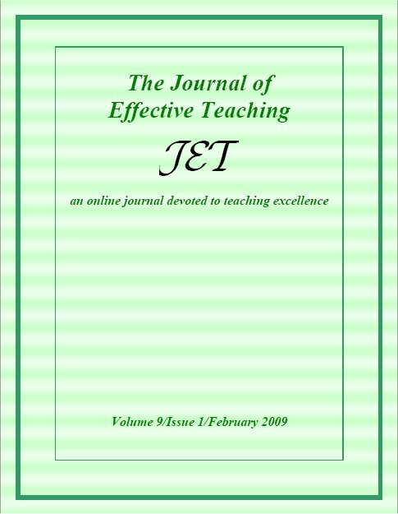
[The creative act] seldom follows a period of intensive reflection; often it occurs much later, when least unexpected....
Jose Gomez
(University of Alabama)
Jose Gomez, “What Do We Know About Creativity?” The Journal of Effective Teaching, Vol. 7, No. 1, 2007, 33, 36.

Slide 15
Creative students soon become detached enough to see the problem in its total perspective. By setting work aside temporarily, creative persons give ideas the freedom to develop.
Jose Gomez
(University of Alabama)
Jose Gomez, “What Do We Know About Creativity?” The Journal of Effective Teaching, Vol. 7, No. 1, 2007, 33, 36.

Slide 16

Ever notice how some of your best ideas occur when you are NOT working, even when you are on vacation?
William Klemm
(Retired Colonel in the US Air Force; Professor Veterinary Med.)
William R. Klemm, “Leadership: Creativity and Innovation,” Concepts of Air Force Leadership. 455

Slide 17
Most creativity theorists believe that it is important, even essential, to have an intense and sustained grappling with a problem if creative solutions are to emerge,
William Klemm
(Retired Colonel in the US Air Force; Professor Veterinary Med.)
William R. Klemm, “Leadership: Creativity and Innovation,” Concepts of Air Force Leadership. 455

Slide 18
but often the flash of insight will only occur when you stop thinking about the problem.
Does NOT refer to mental passivity!
It means we oscillate between times of reflection and relaxation.
William Klemm
(Retired Colonel in the US Air Force; Professor Veterinary Med.)
William R. Klemm, “Leadership: Creativity and Innovation,” Concepts of Air Force Leadership. 455

Slide 19
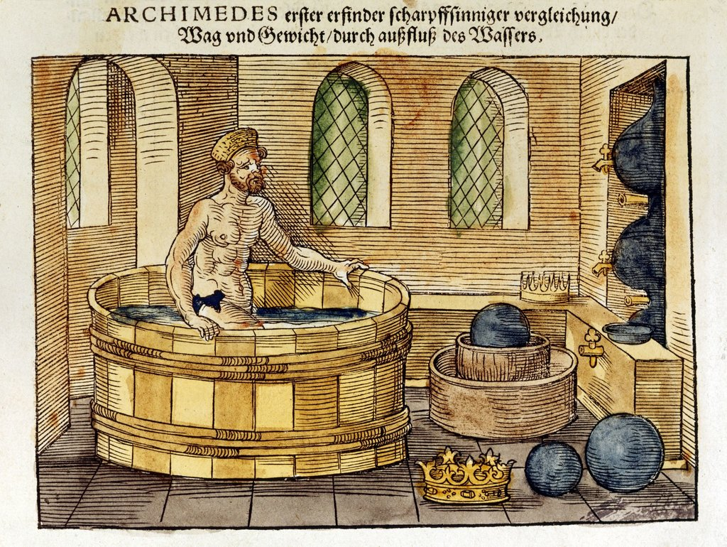
Archimedes
Eureka!
(“I have found it!”
Notes:
Archimedes was taking a bath when he realized water displacement could show him the integrity of the gold in the king’s crown. He famously shouted, “Eureka!” (“I have found it!”), running down the streets of Syracuse naked.
The veracity of this famous story has been called into question. See David Biello, “Fact or Fiction?: Archimedes Coined the Term ‘Eureka!’ in the Bath,” Scientific American (Dec. 8, 2006).

Slide 20
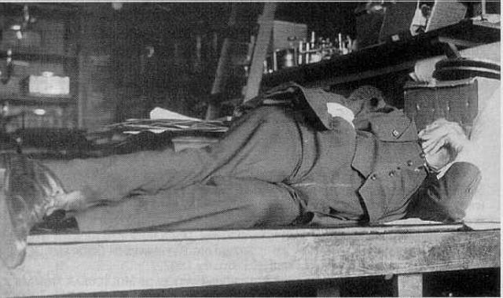
Thomas Edison
Notes:
Thomas Edison would hold a brass ball in his hand and lay down on his recliner. When he drifted to sleep, the ball would fall and hit a metal tin underneath and wake him up. These little cat naps were just enough to allow his mind to relax, so that he could refresh his thinking.
Thomas F. Collura, Technical Foundations of Neurofeedback (New York: Routledge, 2014), 134.

Slide 21
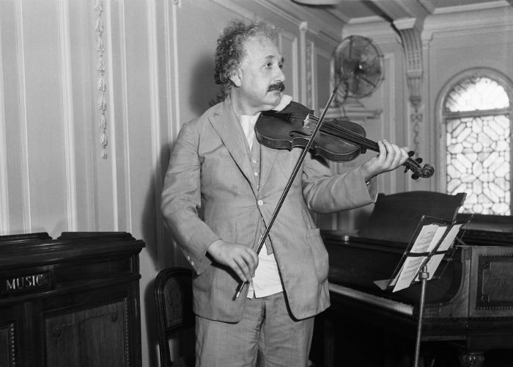
Albert Einstein
Spending time in nature stimulates creativity.
Brendan Lynch, “Researchers find time in wild boosts creativity, insight and problem solving.” The University of Kansas News Service. April 23, 2012.
Notes:
Albert Einstein would play violin or take long walks in the woods. He did this for a decade as a patent clerk in Switzerland before publishing his general theory of relativity.
Gregg Fraley “Creativity and Imagination,” TEDx.

Slide 22
Explore all possible solutions.
Pros and cons list.
Welcome criticism.
Innovation or invention?
The best idea wins!
How do we become creative?
1. Recognize the problem
2. Research it
3. Rack your brain
4. Rest and relaxation
5. Rational assessment

Slide 23
What implications might this research have on Christian leadership?
Leaders meetings?
Teaching?
Discipleship?
Prayer meeting?

Slide 24
What might be some barriers to creativity?
Culture of criticism
Fear of failure
Cynicism or discouragement
Feeling threatened
Lack of leadership
Lack of personal responsibility

Slide 25

Are your leaders’ meetings times of creativity—or just negativity?
Do I spend more time complaining than I do thinking creatively?
Am I a “one trick pony” as a teacher?
Do I try the same methods for motivation over and over, but without noticeable results?

